Slide 1
DataBases
Relational Model -
Relational Algebra @ Calculus

Slide 2
Suppose you are given a relation R with four attributes ABCD. (a) Identify the candidate key(s) for R. (b) Identify the best normal form that R satisfies (1NF, 2NF, 3NF, or BCNF). (c) If R is not in BCNF, decompose it into a set of BCNF relations that preserve the dependencies.
1. C → D, C → A, B → C
2. B → C, D → A

Slide 3
Objectives
Explain why relational database model became practical in about 1980 and de facto standard today
Define basic relational database terms such as relation and tuple
Describe major types of keys including primary, candidate, and foreign
Describe how one-to-one, one-to-many, and many-to-many relationships are implemented

Slide 4
Objectives
Describe how relational data retrieval is accomplished using the relational algebra select, project, and join operators
Understand how the join operator facilitates data integration in relational database
Describe also relational calculus

Slide 5
Relational model
Professionals in any discipline need to know the foundations of their field
Database Professional - need to know theory of relations
is not product-specific;
rather, it is concerned with principles

Slide 6
Principles, not Products
principle
source, root, origin; which is fundamental; essential nature; theoretical basis
principles endure
by contrast, products and technologies, change all the time

Slide 7
Relation Model
E. F. Codd, at the time researcher at IBM; late in 1968 that Codd, a mathematician, first realized that discipline of mathematics could be used to inject some solid principles and rigor into field of database

Slide 8
original definition of relational model
E. F. Codd
Derivability, Redundancy, and Consistency of Relations Stored in Large Data Banks, IBM Research Report RJ599, 1969.
A Relational Model of Data for Large Shared Data Banks, CACM 13, No. 6, 1970.
C. J. Date
An Introduction to Database Systems, 8th Ed. Boston, Mass.: Addison-Wesley, 2004.
first edition of book was published in 1975

Slide 9
Historical perspective
Relational Database Management System (RDBMS) has become dominant data-processing software in use today, with an estimated total software revenue worldwide of US$ 20-30 billion
software represents second generation of DBMSs based on proposed relational data model in 1970, Edgar Codd, at IBM's San Jose Research Laboratory

Slide 10
Historical perspective
in relational model, all data is logically structured within relations (tables); each relation has name and is made up of named attributes (columns) of data; each tuple (row) contains one value per attribute
great strength of relational model is this simple logical structure; behind this structure is sound theoretical foundation that is lacking in first generation of DBMSs (network & hierarchical)

Slide 11
Mathematics
always strive for elegance and orthogonality - dislike exceptions
system is said to be designed in an orthogonal way if its set of components that together make up whole system capability are non-overlapping and mutually independent
each capability should be implemented by only one component
one component should only implement one capability of system

Slide 12
Mathematics
well-separated and independent components ensure that there are no side effects: using or even changing one component does not cause side effects in another area of system
formal disciplines, most relevant ones in application of mathematics to field of databases
Set theory

Slide 13
Mathematics
Everything should be made as simple as possible, but not simpler.
Albert Einstein (1879–1955)

Slide 14
Codd relational model’s objectives
to allow high degree of data independence; application programs must not be affected by modifications to internal data representation, particularly by changes to file organizations, record orderings, or access paths
to provide substantial grounds for dealing with data semantics, consistency, and redundancy problems; introduced concept of normalized relations that have no repeating groups
to enable expansion of set-oriented data manipulation languages

Slide 15
1 - Prototype relational DBMS System R
at IBM’s San José Research Laboratory in California - prototype relational DBMS System R, which was developed during the late 1970s
project was designed to prove practicality of relational model by providing an implementation of its data structures and operations
proved to be excellent source of information about implementation concerns such as transaction management, concurrency control, recovery techniques, query optimization, data security and integrity, human factors, and user interfaces,

Slide 16
led to two major developments
development of a structured query language called SQL, which has since become formal International Organization for Standardization (ISO) and de facto standard language for RDBMS
production of various commercial relational DBMS products during late 1970s and 1980s: IBM DB2 and Oracle

Slide 17
2 - INGRES
development of relational model INGRES (Interactive Graphics Retrieval System) project at University of California at Berkeley
involved development of prototype RDBMS, with research concentrating on same overall objectives as System R project - led to an academic version of INGRES, which contributed to general appreciation of relational concepts, and spawned commercial products INGRES

Slide 18
Terminology and structural concepts of relational model
relational model is based on mathematical concept of relation, which is physically represented as table
we explain terminology and structural concepts of the relational model

Slide 19
Relation
is a table with columns and rows
RDBMS requires only that database be perceived by user as tables
perception applies only to logical structure of database: external and conceptual levels of ANSI-SPARC architecture
does not apply to physical structure of database, which can be implemented using variety of storage structures

Slide 20
Attribute
is named column of relation
relations used to hold information about objects to be represented in database as a two-dimensional table in which rows correspond to individual records and columns correspond to attributes
attributes can appear in any order and relation will still be the same - therefore will convey same meaning

Slide 21
Domain
is set of allowable (possible) values for one or more attributes
may be distinct for each attribute, or two or more attributes may be defined on same domain
typically there will be values in domain that do not currently appear as values in corresponding attribute

Slide 22
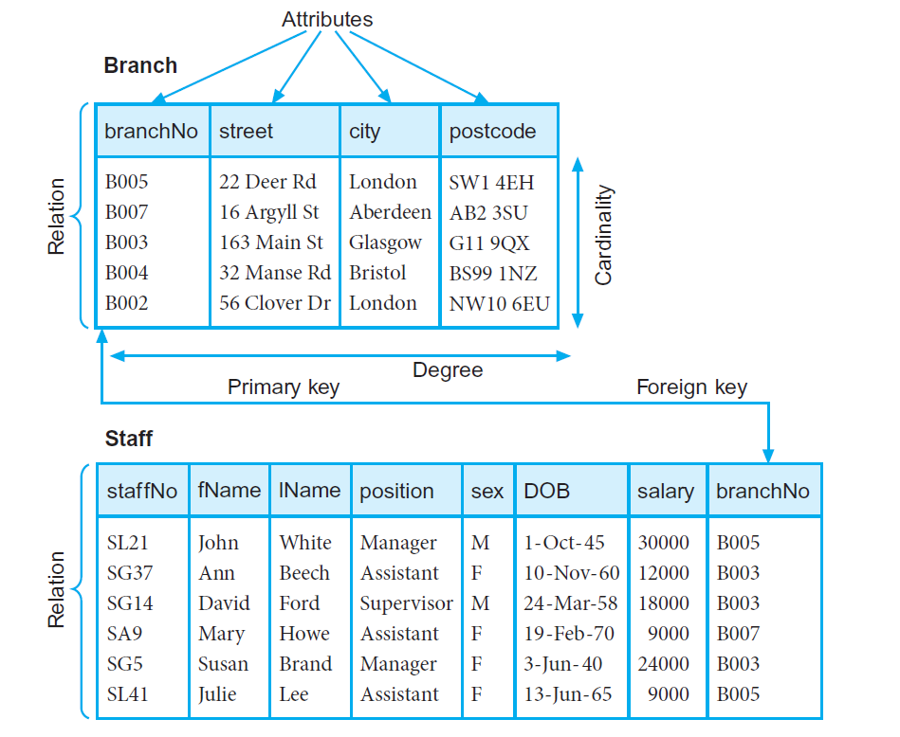
Instances of Branch & Staff relation

Slide 23
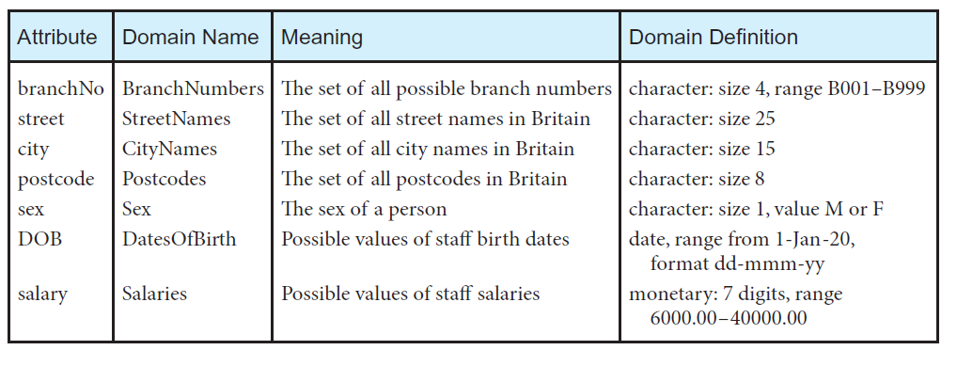
Domains for some attributes

Slide 24
tuple
is row of relation
elements of relation are rows or tuples in table
tuples can appear in any order and relation will still be the same - therefore convey same meaning
structure of relation, together with specification of domains and any other restrictions on possible values, is called its intension; usually fixed - tuples are called extension (or state) of relation, which changes over time

Slide 25
Degree
is number of attributes it contains
the Branch relation has four attributes or degree four – means that each row of table is a four-tuple, containing four values
degree of a relation is property of intension of relation

Slide 26
Cardinality
is number of tuples it contains
changes as tuples are added or deleted; is property of extension of relation and is determined from particular instance of relation at any given moment

Slide 27
Relational database
collection of normalized relations with distinct relation names
consists of relations that are appropriately structured - refer to this as normalization

Slide 28
Alternative terminology
third set of terms is sometimes used; stems from fact that, physically, RDBMS may store each relation in a file

Slide 29
Alternative terminology
Formal term | Logical | Physical
Relation | Table | File
Attribute | Column | Field
Tuple | Row | Record

Slide 30
Mathematical Relations

Slide 31
Sets and Elements
set is a collection of objects, and those objects are called the elements of the set
set is fully characterized by its distinct elements, and nothing else but these elements

Slide 32
Sets and Elements
elements of set don’t have any ordering
sets don’t contain duplicate elements
two sets A and B, are the same if each element of A is also an element of B and each element of B is also an element of A
∅ the empty set

Slide 33
Sets and Elements
set theory has a mathematical symbol ∈ that is used to state that some object is an element of some set
x ∈ S
x ∉ S ↔ ¬(x ∈ S)

Slide 34
Methods to specify sets
enumerative method
S1 := {1, 2, 3, 5, 7, 11, 13, 17, 19, 23}
predicative method
S2 := {x ∈ S | P(x) }
let P(x) be a given predicate with exactly one parameter named x of type S
substitutive method
S3 := { x² | x ∈ N}

Slide 35
Cardinality
sets can be finite and infinite
when dealing with databases all your sets are finite by definition
for every finite set S, cardinality is defined as number of elements of S

Slide 36
Subsets, Supersets
A is a subset of B (B is a superset of A) if every element of A is an element of B
A ⊆ B
A is proper subset of B (B is proper superset of A) if A is subset of B and A ≠ B
A ⊂ B

Slide 37
Union, Intersection, Difference
union A ∪ B = { x | x ∈ A ∨ x ∈ B}
intersection A ∩ B = { x | x ∈ A ∧ x ∈ B}
difference A – B = { x | x ∈ A ∧ x ∉ B}

Slide 38
(Binary) Relation
two sets, D₁ and D₂, where D₁ = {2, 4} and D₂ = {1, 3, 5}; Cartesian product of these two sets, written D₁ × D₂, is set of all ordered pairs such that first element is a member of D₁ and second element is a member of D₂ - D₁ × D₂ = {(2, 1), (2, 3), (2, 5), (4, 1), (4, 3), (4, 5)}
any subset of this Cartesian product is a relation

Slide 39
Example of relation R
R = {(2, 1), (4, 1)}
R = {(x, y) | x ∈ D₁, y ∈ D₂, and y = 1}
easily extend notion to three sets; let D₁, D₂, and D₃ be sets; Cartesian product D₁×D₂×D₃ of these three sets is set of all ordered triples such that first element is from D₁, second is from D₂ and third element is from D₃
any subset of Cartesian product is relation

Slide 40
N-ary Relation
order of coordinates of ordered pair is important
order of tuples it is not important – it is subset of Cartesian – subset of a set is a set – order of element in a set it is not important
can extend three sets to a more general concept of n-ary relation

Slide 41

Relation
define general relation on n domains
let D₁, D₂, . . . , D_{n} be n sets
Cartesian product is defined as:
D₁ × D₂ × . . . × D_{n} = {(d₁, d₂, . . . , d_{n}) | d₁∈D₁, d₂∈D₂, . . . , d_{n}∈D_{n} and is usually written as
any set of n-tuples from this Cartesian product is relation on n sets

Slide 42
DataBase Relations
note that in defining these relations we have to specify sets, or domains, from which we choose values
Relation schema: named relation defined by set of attribute and domain name pairs
let A₁, A₂, . . . , A_{n} be attributes with domains D₁, D₂, . . . , D_{n}
then set {A₁:D₁, A₂:D₂, . . . , A_{n}:D_{n}} is relation schema

Slide 43
DataBase Relations
relation R defined by relation schema is set of mappings from attribute names to their corresponding domains
relation R is set of n-tuples:
(A₁:d₁, A₂:d₂, . . . , A_{n}:d_{n}) such that d₁ ∈ D₁, d₂ ∈ D₂, . . . , d_{n} ∈ D_{n}
each element in n-tuple consists of attribute and value for that attribute

Slide 44
DataBase Relations
normally we list attribute names as column headings and write out tuples as rows having form (d₁, d₂, . . . , d_{n}), where each value is taken from appropriate domain
Relation is any subset of Cartesian product of domains of attributes
table is simply physical representation of such relation

Slide 45
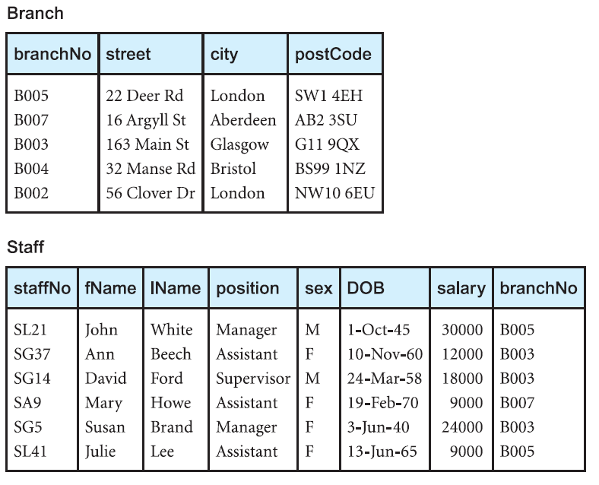
Branch and Staff relations

Slide 46
it shows for example that employee John White is manager with salary of 30,000, who works at branch (branchNo) B005, which, from first table, is at 22 Deer Rd in London
there is relationship between Staff and Branch: branch office has staff
there is no explicit link between these two tables; it is only by knowing that attribute branchNo in Staff have same value as branchNo of Branch

Slide 47
Branch relation
has attributes branchNo, street, city, and postcode, each with its domain
is any subset of Cartesian product of domains, or any set of four-tuples in which first element is from domain BranchNumbers, second is from domain StreetNames, …

Slide 48
Branch relation instance
one of tuples is: or more correctly
{(B005, 22 Deer Rd, London, SW1 4EH)}
{(branchNo: B005, street: 22 Deer Rd, city: London, postcode: SW1 4EH)}
we refer to this as relation instance
Branch table is convenient way of writing out all tuples that form relation at specific moment in time

Slide 49
Relational database schema
set of relation schemas, each with distinct name
in same way that relation has schema, so too does relational database
if R₁, R₂, . . . , R_{n} are set of relation schemas, then we can write relational database schema, or simply relational schema, R, as: R = {R₁, R₂, . . . , R_{n}}

Slide 50
Properties of Relations
relation has name that is distinct from all other relation names in relational schema
each cell of relation contains exactly one atomic (single) value; relations do not contain repeating groups
relation that satisfies this property is said to be normalized in first normal form

Slide 51
Properties of Relations
each attribute has distinct name
value of attribute are all from same domain
each tuple is distinct; there are no duplicate tuples
order of attributes has no significance
order of tuples has no significance
most of properties specified result from properties of mathematical relations

Slide 52
Relational Keys
… there are no duplicate tuples ...
therefore, we need to identify one or more attributes (relational keys) that uniquely identifies each tuple in relation

Slide 53
Superkey
attribute, or set of attributes, that uniquely identifies tuple within relation
may contain additional attributes that are not necessary for unique identification
interested in identifying superkeys that contain only minimum number of attributes necessary for unique identification

Slide 54
Candidate Key
superkey such that no proper subset is superkey within relation
Uniqueness – in each tuple of R, values of K uniquely identify that tuple
Irreducibility - no proper subset of K has uniqueness property
when key consists of more than one attribute, we call it composite key
there may be several candidate keys for relation

Slide 55
Candidate Key
consider Branch relation
given value of city, we can determine several branch offices (London has two branch offices)
attribute cannot be a candidate key
company allocates each branch office unique branch number we can determine at most one tuple, so that branchNo is candidate key
similarly, postcode is also candidate key

Slide 56
Candidate Key
consider relation Viewing, which contains information relating to properties viewed by clients
relation comprises client number (clientNo), property number (propertyNo), date of viewing (viewDate) and, optionally, comment (comment)

Slide 57
Candidate Key
combination of clientNo and propertyNo identifies at most one tuple, so for Viewing together form (composite) candidate key
if we take into account possibility that client may view property more than once, then we could add viewDate to composite key

Slide 58
Candidate Key
instance of relation cannot be used to prove that attribute or combination of attributes is CK
fact that there are no duplicates for values that appear at particular moment in time does not guarantee that duplicates are not possible
presence of duplicates in instance can be used to show that attribute combination is not CK
identifying candidate key requires that we know the “real-world” meaning of attribute(s) involved; can decide whether duplicates are possible

Slide 59
Primary Key
candidate key that is selected to identify tuples uniquely within relation (by database designer)
relation has no duplicate tuples; always possible to identify each row uniquely
relation always has primary key
in worst case, entire set of attributes could serve as primary key; usually some smaller subset is sufficient to distinguish tuples

Slide 60
Alternate Key
candidate keys that are not selected to be primary key
for Branch relation, if we choose branchNo as primary key, postcode would then be an alternate key
for Viewing relation, there is only one candidate key, comprising clientNo and propertyNo, so these attributes would automatically form primary key

Slide 61
Foreign Key
attribute, or set of attributes, within one relation that matches candidate key of some (possibly same) relation
when attribute appears in more than one relation, its appearance usually represents relationship between tuples of two relations
for example, inclusion of branchNo in both Branch and Staff relations is quite deliberate and links each branch to details of staff working at that branch

Slide 62
Foreign Key
in Branch relation, branchNo is primary key
in Staff relation, branchNo attribute exists to match staff to branch office they work in
in Staff relation, branchNo is foreign key
we say that attribute branchNo in Staff relation targets primary key attribute branchNo in home relation, Branch

Slide 63
Representing Relational Database Schemas
Branch (branchNo, street, city, postcode)
Staff (staffNo, fName, IName, position, sex, DOB, salary, branchNo)
PropertyForRent (propertyNo, street, city, postcode, type, rooms, rent, ownerNo, staffNo, branchNo)
Client (clientNo, fName, IName, telNo, prefType, maxRent, eMail)

Slide 64
Representing Relational Database Schemas
PrivateOwner (ownerNo, fName, IName, address, telNo, eMail, password)
Viewing (clientNo, propertyNo, viewDate, comment)
Registration (clientNo, branchNo, staffNo, dateJoined)

Slide 65
Representing Relational Database Schemas
common convention for representing relation schema is to give name of relation followed by attribute names in parentheses; primary key is underlined
conceptual model, or conceptual schema, is set of all such schemas for database

Slide 66
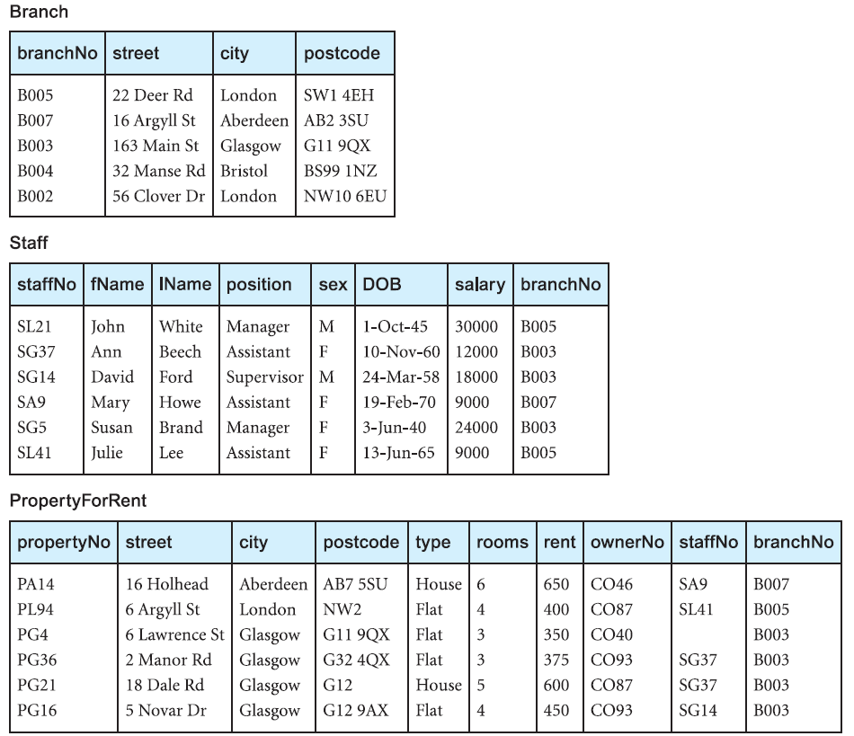
Instance of rental database

Slide 67
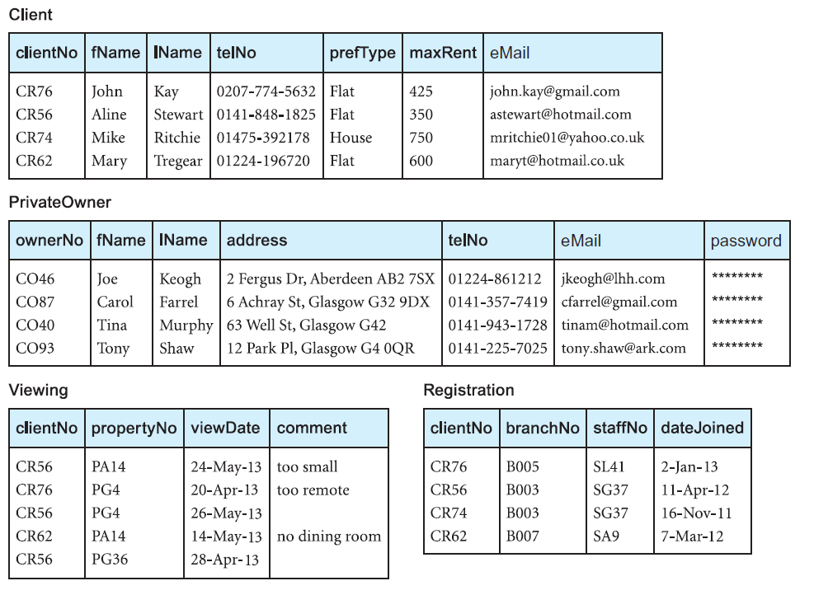
Instance of rental database

Slide 68
Null
represents value for attribute that is currently unknown or is not applicable for this tuple
mean logical value “unknown”, value is not applicable to particular tuple, or that no value has yet been supplied
way to deal with incomplete or exceptional data
not same as zero or empty text string
represents absence of value

Slide 69
Null
for example, in Viewing relation comment attribute may be undefined until potential renter has visited property and returned comment to agency
without nulls, it becomes necessary to introduce false data to represent this state

Slide 70
Null
can cause implementation problems, arising from fact that relational model is based on first-order predicate calculus, which is two-valued or Boolean logic; allowing nulls means that we have to work with higher-valued logic, such as three-valued logic (true, false, null)
Codd regarded nulls as an integral part of relational model

Slide 71
Integrity Constraints
relational integrity constraints ensure that data is accurate
because every attribute has an associated domain, there are domain constraints that form restrictions on set of values allowed for attributes of relations
integrity rules - constraints that apply to all instances of database: entity integrity and referential integrity

Slide 72
Integrity Constraints
because every attribute has an associated domain, there are domain constraints that form restrictions on set of values allowed for attributes of relations
integrity rules - constraints that apply to all instances of database: entity integrity and referential integrity

Slide 73
Entity integrity
in base relation, no attribute of primary key can be null
PK is minimal identifier used to identify tuples uniquely; if we allow null for any part of PK we are implying that not all attributes are needed
for example, branchNo is PK of Branch, we should not be able to insert tuple with null
Viewing (clientNo, propertyNo, …) we should not be able to insert tuple into Viewing with null for clientNo or null for propertyNo or nulls for both

Slide 74
Entity integrity
using data of Viewing relation consider query “List all comments from viewings”
produce unary relation consisting of attribute comment
this attribute must be PK, but it contains nulls
this relation is not base relation (derived relation), model allows primary key to contain nulls

Slide 75
Referential integrity
if foreign key exists in relation, either foreign key value must match a candidate key value of some tuple in its home relation or foreign key value must be wholly null

Slide 76
Referential integrity
for example, branchNo in Staff is FK targeting branchNo attribute in home relation, Branch
possible to create Staff record with branchNo B025, if there is already branchNo B025 in Branch relation
we should be able to create Staff record with null branchNo to allow for situation where member of staff has joined company but has not yet been assigned to particular branch office

Slide 77
General constraints
additional rules specified by users of database that define or constrain some aspect of organization
for example, if an upper limit of 20 has been placed upon number of staff that may work at branch office
level of support for general constraints varies from system to system

Slide 78
General constraints
declarative integrity constraint is statement about database that is always true
trigger is procedural code that is automatically executed in response to certain events on particular table or view in database; mostly used for maintaining integrity of information

Slide 79
Views
in relational model has slightly different meaning then view from architecture
rather than being entire external model of user’s view, view is virtual or derived relation that does not necessarily exist in its own right, but may be dynamically derived from one or more base relations
external model can consist of both base (conceptual-level) relations and views derived from base relations

Slide 80
Views
relation that appears to user to exist, can be manipulated as if it were base relation, but does not necessarily exist in storage (although its definition is stored in system catalog)
contents of view are defined as query on one or more base relations
operations on view are automatically translated into operations on relations from which it is derived

Slide 81
Views
dynamic – changes made to base relations that affect view are immediately reflected in view
when users make permitted changes to (updating) view, these changes are made to underlying relations

Slide 82
Views
provides powerful and flexible security mechanism by hiding parts of database from certain users; users are not aware of existence of any attributes or tuples that are missing
it permits users to access data in way that is customized to their needs, same data can be seen by different users in different ways
it can simplify complex operations on base relations

Slide 83
Views
for example, if view defined as combination (join) of two relations users may now perform more simple operations on view, which will be translated by DBMS into equivalent operations
some members of staff should see Staff tuples without salary attribute
attributes may be renamed or order changed; user accustomed to calling branchNo attribute of branches by full name

Slide 84
Views
provides logical data independence; supports reorganization of conceptual schema
for example, if new attribute is added to relation, existing users can be unaware of its existence if their views are defined to exclude it; if existing relation is rearranged or split up, view may be defined so that users can continue to see their original views

Slide 85
Codd’s rules
Codd came up with rules database must obey in order to be regarded as relational
hardly any commercial product follows all

Slide 86
Rule 0: Foundation
system must qualify as relational, as a database, and as a management system
system must use its relational facilities (exclusively) to manage database
foundation rule, which acts as base for all other 12 rules derive from this

Slide 87
Rule 1: Information
all information in database is to be represented in one and only one way, namely by values in column positions within rows of tables
data stored in database, may it be user data or metadata, must be value of some table cell; everything in database must be stored in a table format

Slide 88
Rule 2: Guaranteed Access
all data must be accessible; essentially restatement of fundamental requirement for primary keys; every individual scalar value in database must be logically addressable by specifying name of table, name of column and primary key value
every single data element (value) is guaranteed to be accessible logically with combination of table-name, primary-key (row), and attribute-name (column); no other means, such as pointers, can be used to access data

Slide 89
Rule 3: Systematic Treatment of NULL Values
DBMS must allow each field to remain null (or empty); must support representation of "missing information and inapplicable information" that is systematic, distinct from all regular values (0, “”, …), and independent of data type; manipulated by DBMS in systematic way
NULL values in database must be given systematic and uniform treatment; interpreted as − data is missing, data is not known, or data is not applicable

Slide 90
Rule 4: Active Online Catalog
system must support online relational catalog that is accessible to authorized users by means of their regular query language; users must be able to access database's structure (catalog) using same query language that they use to access database's data
structure description of entire database must be stored in online catalog, known as data dictionary, which can be accessed by authorized users; users can use same query language to access catalog which they use to access database itself

Slide 91
Rule 5: Comprehensive Data Sub-Language
system must support at least one relational language that
has linear syntax
can be used both interactively and within application programs
supports data definition operations (including view definitions), data manipulation operations (update and retrieval), security and integrity constraints, transaction management operations (begin, commit, and rollback)

Slide 92
Rule 5: Comprehensive Data Sub-Language
database can only be accessed using language having linear syntax that supports data definition, data manipulation, and transaction management operations; language can be used directly or by means of some application
if database allows access to data without any help of this language, then it is considered violation

Slide 93
Rule 6: View Updating
all views those can be updated theoretically, must be updated by system.
all views of database, which can theoretically be updated, must also be updatable by system

Slide 94
Rule 7: High-Level Insert, Update, and Delete
system must support set-at-a-time insert, update, and delete operators; data can be retrieved from relational database in sets constructed of data from multiple rows and/or multiple tables; insert, update, and delete operations should be supported for any retrievable set rather than just for single row in single table

Slide 95
Rule 7: High-Level Insert, Update, and Delete
database must support high-level insertion, updation, and deletion; this must not be limited to single row, that is, it must also support union, intersection and minus operations to yield sets of data records

Slide 96
Rule 8: Physical Data Independence
changes to physical level (how data is stored, whether in arrays or linked lists etc.) must not require change to application based on structure
data stored in database must be independent of applications that access database; any change in physical structure of database must not have any impact on how data is being accessed by external applications

Slide 97
Rule 9: Logical Data Independence
changes to logical level (tables, columns, rows, …) must not require change to application based on structure; more difficult to achieve
logical data in database must be independent of its user’s view (application); any change in logical data must not affect applications using it

Slide 98
Rule 10: Integrity Independence
integrity constraints must be specified separately from application programs and stored in catalog; it must be possible to change such constraints as and when appropriate without unnecessarily affecting existing applications
database must be independent of application that uses it; all its integrity constraints can be independently modified without need of any change in application; makes database independent of front-end application & interface

Slide 99
Rule 11: Distribution Independence
distribution of portions of database to various locations should be invisible to users; existing applications should continue to operate
when distributed version is first introduced
when existing distributed data are redistributed
end-user must not be able to see that data is distributed over various locations; users should always get impression that data is located at one site only;
regarded as foundation of distributed database

Slide 100
Rule 12: Non-Subversion Rule
if system provides low-level (record-at-a-time) interface, then that interface cannot be used to subvert system; bypassing relational security or integrity constraint
if system has an interface that provides access to low-level records, then interface must not be able to subvert system and bypass security and integrity constraints

Slide 101
Relational model three major components
structure
integrity
manipulation

Slide 102
Relation
are defined over domains, (data types)
domain set of values from which actual attributes in actual relations take their actual values
n-ary relations can be pictured as table with n columns
columns correspond to attributes of relation
rows correspond to tuples

Slide 103
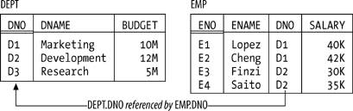
Departments and Employees database sample values

Slide 104
Keys
every relation has at least one candidate key - unique identifier
combination of attributes such that every tuple in relation has unique value for combination in question
primary key is candidate key that's been singled out for special treatment

Slide 105
Keys
candidate keys, not primary keys, are significant from relational point of view
foreign key is set of attributes in one relation whose values are required to match values of some candidate key in some other relation (or possibly in same relation)

Slide 106
Integrity Constraint
basically just boolean expression that must evaluate to TRUE
in case of departments and employees, for example, we might have constraint to effect that SALARY values must be greater than 0
Entity integrity
primary key attributes don't permit nulls.
Referential integrity
there mustn't be any unmatched foreign key values
null is "marker" that means value unknown

Slide 107
Manipulation
set of relational operators, collectively called relational algebra
relational assignment operator

Slide 108
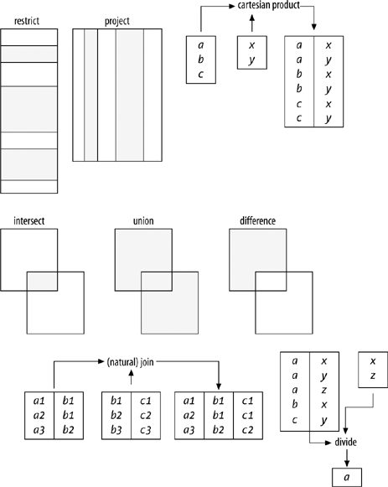
Relational Algebra

Slide 109
Properties of Relations
every relation has heading and body
heading is set of attributes (name, type pair)
body is set of tuples that conform to that heading
relation doesn't really contain tuples, it contains body, and that body in turn contains tuples

Slide 110
Properties of Relations
number of attributes in heading is the degree (arity), and number of tuples in body is the cardinality
tuples of relation are unordered; follows because body is set, and sets in mathematics have no ordering to their elements
attributes of relation are also unordered because heading too is mathematical set

Slide 111
Properties of Relations
relations never contain duplicate tuples; follows because body is set of tuples, and sets in mathematics do not contain duplicate elements
relational operations always produce result without duplicate tuples
SQL results are allowed to contain duplicate rows

Slide 112
Properties of Relations
relations are always normalized (1NF); at every row-and-column intersection we always see just single value

Slide 113
Tuple
Let T₁, T₂, ... , T_{n}, (n > 0) be type names, not necessarily all distinct.
Associate with each T_{i} a distinct attribute name, A_{i}; each of the n attribute-name : type-name combinations that results is an attribute.
Associate with each attribute a value v_{i} of type T_{i}; each of the n attribute : value combinations that results is component.
set of all n components thus defined, t say, is tuple value (or just tuple for short) over the attributes A₁, A₂, ... , A_{n}
value n is the degree of t;
set of all n attributes is the heading of t

Slide 114
Relation
Let {H} be a tuple heading and let t₁, t₂, ... , t_{n}, (n > 0) be distinct tuples with heading {H}.
The combination, r say, of {H} and the set of tuples {t₁, t₂, ... , t_{n}} is a relation value (or just relation for short) over attributes A₁, A₂, ... , A_{n}, where A₁, A₂, ... , A_{n} are the attributes in {H}.
heading of r is {H}
r has same attributes that heading does
body of r is set of tuples {t₁, t₂, ... , t_{n}}

Slide 115
theory and practice of relational database
treatment of the theory
rigorous and mathematical
presents two formal query languages associated with relational model
query languages are specialized languages for asking questions that involve data in a database

Slide 116
convinced that familiarity with areas of mathematics that will be presented and on which the relational model of data is based, is a strong prerequisite for anybody who aims to be professionally involved with databases

Slide 117
Mathematics
always strive for elegance and orthogonality - dislike exceptions
system is said to be designed in an orthogonal way if its set of components that together make up whole system capability are non-overlapping and mutually independent
each capability should be implemented by only one component
one component should only implement one capability of system

Slide 118
Mathematics
well-separated and independent components ensure that there are no side effects: using or even changing one component does not cause side effects in another area of system
two formal disciplines, most relevant ones in application of mathematics to field of databases
Logic
Set theory

Slide 119
Mathematics
Everything should be made as simple as possible, but not simpler.
Albert Einstein (1879–1955)

Slide 120
Relations

Slide 121
Relation
common misconception that word relational in “relational model of data, relational database” refers to relationships” (many-to-one, many-to-many, and so on) that can exist between different entity types
nothing to do with R of ERD
Entity Relationship Diagrams

Slide 122
Relation
word refers to mathematical concept of a (n-ary) relation, mathematical, set-theory concept
Binary Relations

Slide 123
Binary Relations
from set A to set B is defined as subset of Cartesian product A × B
called binary relation because it deals with two sets (A and B)
order of coordinates of ordered pair is important
example based on A := {X, Y ,Z}, B := {1, 2}
R1 := {(X; 1), (X; 2), (Y; 1), (Z; 2)}
(∀ p ∈ R1: p ∈ A × B )

Slide 124
Binary Relations
R is a binary relation from set A to set B ↔ R ∈ ℘(A × B)
Functions

Slide 125
Functions
binary relation that doesn’t have two elements that have same first coordinate
in function two distinct ordered pairs always have different first coordinates
F ∈ ℘(A × B) ∧
(∀ p1,p2 ∈ F: p1≠p2 →π₁(p1) ≠ π₁(p2)) ∧
{π₁(p1) | p ∈ F } = A

Slide 126
Functions
dom(F) = A
rng(F) ⊆ B

Slide 127
Identity Function
over A if A is domain of f, and for all elements x in set A, f of x equals x
id(A) to represent identity function over A

Slide 128
Subset of Function
every proper subset of function F is again a function

Slide 129
N-ary Relation
more general concept of n-ary relation (that is, not just a binary one)
concept introduced by database field

Slide 130
Operations on Functions
functions are sets, can apply set operators union, intersection, and difference

Slide 131
Compatible (Joinable) Functions
generic property that two functions F and G should have for union of those two functions to result in a function
function F is compatible with function G ↔
(∀ c ∈(dom(F) ∩ dom(G)): F(c)=G(c))

Slide 132
Function Composition
let A, B, and C be sets
let f be a function over A into B
let g be a function over rng(f) into C
composition of functions f and g, notation g○f, is defined as
g○f := {(a; g(f(a)) | a ∈ dom(f) ∧ f(a) ∈ dom(g)}

Slide 133
Limitation of Function
subset of given function, want to consider those ordered pairs whose first coordinate can be chosen from some given subset of the domain of the function
F↓A := { p | p ∈ F ∧ π₁(p) ∈ A}

Slide 134
Set Functions
function in which every ordered pair holds a set as its second coordinate
H := { (team; {'Cowboys', 'Vikings', 'Saints', 'Cardinals'}), location; {'Dallas', 'Minnesota', 'New Orleans', 'Arizona'})}

Slide 135
can consider set function H to enumerate, through first coordinates of its ordered pairs, two aspects of team: name of team (coordinate team) and location of team (coordinate location)
such first coordinates are referred to as attributes
attached to these attributes are the value sets as second coordinates of ordered pairs that could be considered to represent set of possible values for these attributes

Slide 136
Characterizations
can consider set function H to characterize a player
set function called characterization when you use it to describe something in real world by listing relevant attributes in combination with set of admissible values for each attribute
relevant attributes are first coordinates of ordered pairs
sets of admissible values are their respective second coordinates attribute value sets

Slide 137
External Predicates
characterizations can be considered to characterize predicate in real world
characterization introduces (names of) parameters of predicate and corresponding value sets from which these parameters can take their values

Slide 138
Characterizations
H := {
(empno; [1..99]),
(ename; varchar(10)),
(born; date),
(job; {'CLERK', 'SALESMAN', 'TRAINER', 'MANAGER', 'PRESIDENT'}),
(salary; [1000..4999])
}

Slide 139
External Predicates
previous characterization characterizes following predicate:
employee ENAME is assigned employee number EMPNO, is born at date BORN, holds position JOB, and has a monthly salary of SALARY dollars

Slide 140
characterization will be basis of table design
predicate characterized by characterization of table design represents user-understood meaning of that table design
such predicate is referred to as external predicate of that table

Slide 141
Generalized Product of Set Function
let F be set function
generalized product of F, notation Π(F)
Π(F) = {f | f is a function ∧ dom(f) = dom(F) ∧ (∀ c ∈ dom(f): f(c) ∈ F(c))}

Slide 142
Generalized Product of Set Function
generates set with all possible functions that have same domain as F, and for which the ordered pairs (in these functions) have second coordinate that is chosen from (that is, is an element of) the relevant set that was attached to same first coordinate in F

Slide 143
Π({(a; {1,2,3}), (b; {4,5})}) = {
{(a; 1), (b; 4)}, {(a; 1), (b; 5)},
{(a; 2), (b; 4)}, {(a; 2), (b; 5)},
{(a; 3), (b; 4)}, {(a; 3), (b; 5)} }

Slide 144
H := { (team; {'Cowboys', 'Vikings', 'Saints', 'Cardinals'}), location; {'Dallas', 'Minnesota ', 'New Orleans', 'Arizona'})}
Π(H) =

Slide 145
Π(H) = {
{(team;'Cowboys'), (location;'Dallas')}, {(team;'Cowboys'), (location;'Minnesota')},
{(team;'Cowboys'), (location;'New Orleans')}, {(team;'Cowboys'), (location;'Arizona')},
{(team;'Vikings'), (location;'Dallas')}, {(team;'Vikings'), (location;'Minnesota')},
{(team;'Vikings'), (location;'New Orleans')}, {(team;'Vikings'), (location;'Arizona')},
{(team;'Saints'), (location;'Dallas')}, {(team;'Saints'), (location;'Minnesota')},
{(team;'Saints'), (location;'New Orleans')}, {(team;'Saints'), (location;'Arizona')},
{(team;'Cardinals'), (location;'Dallas')}, {(team;'Cardinals'), (location;'Minnesota')},
{(team;'Cardinals'), (location;'New Orleans')}, {(team;'Cardinals'), (location;'Arizona')} }

Slide 146
refer to functions in result set of generalized product of set function as tuples
such set functions will typically signify a characterization
elements of tuple, ordered pairs, are called attribute-value pairs of tuple
in relational database design, tuple represents proposition in real world

Slide 147
tuple {(empno; 100), (ename;'Smith'), (born; '19-jan-1964'), (job; 'MANAGER'), (salary; 5000) }
denotes proposition “Employee Smith is assigned employee number 100, is born at date 19-jan-1964, holds position MANAGER, and has a monthly salary of 5000 dollars”

Slide 148
Closed world assumption
if given tuple appears in table design, then we assume that proposition denoted by that tuple is currently true proposition in real world

Slide 149
other way around, if a given tuple that could appear in table design, but currently does not appear, then we assume that proposition denoted by that tuple is false proposition in real world
principle is referred to as ”Closed World Assumption” tuples held in database design describe all, and only, currently true propositions in real world

Slide 150
APPLICATION

Slide 151
mathematical foundation laid down
how this can be applied to specify database and database designs

Slide 152
Key Terms
Entity, Entity identifier, Keys
Attribute, Column, Domain of values
Tuple, Row
Equijoin
Relation, Relational model, Relational database
Logic

Slide 153
DataBase
Relational Queries

Slide 154
Query languages
specialized languages for asking questions, or queries, that involve the data in a database
relational algebra - queries are specified operational
set of operators
each query describes a step-by-step procedure for computing the desired answer
relational calculus - queries are specified nonprocedural declarative
expressive power of algebra and calculus ?
these formal query languages have greatly influenced commercial query languages such as SQL, which we will discuss later

Slide 155
Influence on the design of commercial query languages
Structured Query language (SQL)
Query-by-Example (QBE)

Slide 156
inputs and outputs of a query are relations
present a number of sample queries using following schema:
Sailors(sid: integer, sname: string, rating: integer, age: real)
Boats(bid: integer, bname: string, color: string)
Reserves(sid: integer, bid: integer, day: date)

Slide 158
Relational Algebra

Slide 159
Relational algebra
queries composed using a collection of operators
every operator in algebra accepts (one or two) relation instances as arguments and returns a relation instance as the result
compose operators to form a complex query
expression is recursively defined to be
Relation
unary algebra operator applied to a single expression
binary algebra operator applied to two expressions

Slide 160
Relational query
step-by-step procedure for computing the desired answer
procedural nature of the algebra
algebra expression is a recipe, or a plan, for evaluating a query
relational systems in fact use algebra expressions to represent query evaluation plans

Slide 161
Selection and Projection
operators to
select rows from a relation (σ)
project columns (π)
operations allow us to manipulate data in a single relation

Slide 162
Instance of Sailors S₂

Slide 163
σ _{rating > 8} (S₂)

Slide 164
π _{name, rating} (S₂)

Slide 165
Selection operator σ_{selection_condition}
species the tuples to retain through a selection condition
boolean expression using logical connectives ∨ and ∧ of terms that have the form attribute₁ op attribute₂, where op is one of comparison operators <; <=; =; >=; >
reference to an attribute can be by position or by name
schema of result is schema of input relation instance

Slide 166
Projection operator π _{column_list}
projection operator allows us to extract columns from a relation
schema of result of projection is determined by fields that are projected in the column list
result is a relation

Slide 167
π _{age} (S₂)

Slide 168

π _{age} (S₂)

Slide 169
Projection π result is a relation
follows from the definition of a relation as a set of tuples
in practice, real systems often omit the expensive step of eliminating duplicate tuples, leading to relations that are multisets

Slide 170
Composition of relational algebra operators
since result of a relational algebra expression is always a relation, we can substitute an expression wherever a relation is expected
for example, we can compute the names and ratings of highly rated sailors by combining two of the preceding queries
π _{sname,rating} ( σ _{rating>8} (S₂))

Slide 171
Set Operations
following standard operations on sets are also available in relational algebra
union ( ∪ )
intersection ( ∩ )
set-difference ( ― )
cross-product ( Χ )

Slide 172
Union ( ∪ )
R ∪ S returns a relation instance containing all tuples that occur in either relation instance R or relation instance S (or both)

Slide 173
Union-compatible
R and S must be union-compatible, and the schema of the result is defined to be identical to the schema of R (or S)
they have the same number of fields
corresponding fields, taken in order from left to right, have the same domains
for convenience, we will assume that the fields of R ∪ S inherit names from R

Slide 174
Intersection ( ∩ )
R ∩ S returns a relation instance containing all tuples that occur in both R and S
relations R and S must be union-compatible, and the schema of the result is defined to be identical to the schema of R

Slide 175
Set-difference ( ― )
R−S returns a relation instance containing all tuples that occur in R but not in S
relations R and S must be union-compatible, and the schema of the result is defined to be identical to the schema of R

Slide 176
Cross-product ( Χ )
R Χ S returns a relation instance whose schema contains all the fields of R (in the same order as they appear in R) followed by all the fields of S (in the same order as they appear in S)
result of R Χ S contains one tuple <r, s> (the concatenation of tuples r and s) for each pair of tuples r ∈ R; s ∈ S
sometimes called Cartesian product

Slide 177
Cross-product naming conflict
convention that fields of R Χ S inherit names from the corresponding fields of R and S
possible for both R and S to contain one or more fields having the same name
corresponding fields in R Χ S are unnamed and are referred to solely by position

Slide 178
Renaming operator ρ
ρ (R(F), E)
takes an arbitrary relational algebra expression E and returns an instance of a (new) relation called R
R contains same tuples as result of E, and has same schema as E, but some fields are renamed
field names in relation R are same as in E, except for fields renamed in renaming list F

Slide 179
Renaming list
terms having the form oldname → newname or position → newname
to be well-defined, references to fields may be unambiguous, and no two fields in result must have the same name

Slide 180
Additional operators
customary to include some additional operators in algebra, but they can all be defined in terms of already defined operators
renaming operator needed for syntactic convenience
can consider even ∩ operator as redundant, R ∩ S can be defined as R − (R − S)

Slide 181
Join operation
one of the most useful operations in relational algebra
most commonly used way to combine information from two or more relations

Slide 182
Join operation
can be defined as a cross-product followed by selections and projections, joins arise much more frequently in practice than plain cross-products
important to recognize joins and implement them without materializing the underlying cross-product
variants of join operation

Slide 183
Condition Joins
most general version of the join operation accepts a join condition c and a pair of relation instances as arguments, and returns a relation instance
join condition is identical to a selection condition in form

Slide 184
Condition Joins |><|_{c}
R |><|_{c} S = σ_{c} (R X S)
defined to be a cross-product followed by a selection
condition c can (and typically does) refer to attributes of both R and S
reference to an attribute of a relation, say R, can be by position (of form R.i) or by name (of form R.name)

Slide 185
Equijoin |><| _{c}
special case of join operation R |><|S is when join condition consists solely of equalities (connected by ∧) of form R.name₁ = S.name₂, that is, equalities between two fields in R and S
obviously, there is some redundancy in retaining both attributes in result
join operation is refined by doing an additional projection in which S.name₂ is dropped

Slide 186

S₁ |><| _{R.sid=S.sid} R₁

Slide 187
Natural Join |><|
further special case of the join operation R |><| S is an equijoin in which equalities are specified on all fields having the same name in R and S
we can simply omit the join condition
default is that join condition is a collection of equalities on all common fields
result is guaranteed not to have two fields with the same name

Slide 188
if the two relations have no attributes in common, R |><| S is simply the cross-product
several variants of joins that are not discussed
outer joins

Slide 189
Relational Calculus

Slide 190
Relational Calculus
nonprocedural, or declarative,
describe set of answers without being explicit about how they should be computed

Slide 191
Relational Calculus 2 variants
tuple relational calculus (TRC)
variables in TRC take on tuples as values
influence on SQL
domain relational calculus (DRC)
variables range over field values
influenced QBE

Slide 192
Tuple
Relational Calculus

Slide 193
Tuple Relational Calculus
tuple variable is a variable that takes on tuples of a particular relation schema as values
every value assigned to a given tuple variable has the same number and type of fields

Slide 194
Tuple Relational Calculus
tuple relational calculus query has the form {T | p(T) }, where T is a tuple variable and p(T) denotes a formula that describes T
where T is the only free variable in formula p
result of this query is the set of all tuples t for which the formula p(T) evaluates to true with T = t
language for writing formulas p(T) is thus at the heart of TRC and is essentially a simple subset of first-order logic

Slide 195
Tuple Relational Calculus
As a simple example, consider the following query.
Find all sailors with a rating above 7?

Slide 196
Tuple Relational Calculus
{S | S ∈Sailors ∧ S.rating > 7}
answer contains those instances of S that pass this test

Slide 197
Syntax of TRC Queries
Rel - relation name
R and S - tuple variables
a - an attribute of R
b - an attribute of S
op - an operator in the set {<, ≤, ≠, ≥, >}

Slide 198
Atomic formula in TRC
R ∈ Rel
R.a op S.b
R.a op constant
constant op R.a

Slide 199
TRC Formula
recursively defined to be one of the following, where p and q are themselves formulas and p(R) denotes a formula in which variable R appears
any atomic formula
¬ p, p ∨ q, p ∧ q, p ⇒ q
∃ R( p(R)), where R is a tuple variable
∀ R( p(R)), where R is a tuple variable

Slide 200
In the last two clauses quantiers ∀ and ∃ are said to bind the variable R
variable is said to be free in a formula or subformula (a formula contained in a larger formula) if the (sub)formula does not contain an occurrence of a quantier that binds it

Slide 201
observe that every variable in a TRC formula appears in a subformula that is atomic, and every relation schema species a domain for each field
ensures that each variable in TRC formula has a well-defined domain from which values for the variable are drawn
each variable has a well-defined type

Slide 202
Examples of TRC Queries
Find the sailor name, boat id, and reservation date for each reservation?
{P | ∃ R ∈ Reserves ∧ ∃ S ∈ Sailors
(R.sid = S.sid ∧ P.bid = R.bid ∧ P.day = R.day ∧ P.sname = S.sname) }

Slide 203
Examples of TRC Queries
for each Reserves tuple, we look for a tuple in Sailors with the same sid
given a pair of such tuples, we construct an answer tuple P with fields sname, bid, and day by copying corresponding fields from these two tuples

Slide 204
Domain
relational calculus

Slide 205
Domain relational calculus
domain variable ranges over values in domain of some attribute

Slide 206
Domain relational calculus
domain relational calculus query has the form {<x₁, x₂, … , x_{n}> | p(<x₁, x₂, … , x_{n}>)}
where each x_{i} is either a domain variable or a constant and p(<x₁, x₂, … , x_{n}>) denotes a DRC formula whose only free variables are the variables among the x_{i}, 1 ≤ i ≤ n
result of this query is the set of all tuples {<x₁, x₂, … , x_{n}> for which the formula evaluates to true

Slide 207
A DRC formula is defined in a manner that is very similar to the definition of a TRC formula.
difference is that the variables are now domain variables

Slide 208
Syntax of DRC Queries
op - an operator in the set {<, ≤, ≠, ≥, >}
X and Y be domain variables

Slide 209
Atomic formula in DRC
{<x₁, x₂, … , x_{n}> ∈ Rel
where Rel is a relation with n attributes
each x_{i}, 1 ≤ i ≤ n is either variable or constant
X op Y
X op constant
constant op X

Slide 210
DRC Formula
recursively defined to be one of the following, where p and q are themselves formulas and p(X) denotes a formula in which variable X appears
any atomic formula
¬ p, p ∨ q, p ∧ q, p ⇒ q
∃ R( p(R)), where R is a domain variable
∀ R( p(R)), where R is a domain variable

Slide 211
Examples of DRC Queries
Find all sailors with a rating above 7?
{<I, N, T, A> | {<I, N, T, A> ∈Sailors ∧ T > 7 }

Slide 212
Expressive power of algebra and calculus

Slide 213
every query that can be expressed in relational algebra also can be expressed in safe relational calculus

Slide 214
Unsafe queries
consider the query {S | ¬(S ∈ Sailors)
syntactically correct
set of such S tuples is obviously infinite, in the context of infinite domains
restrict relational calculus to disallow unsafe queries

Slide 215
if query language can express all queries that we can express in relational algebra, it is said to be relationally complete
practical query language is expected to be relationally complete
in addition, commercial query languages typically support features that allow us to express some queries that cannot be expressed in relational algebra

Slide 216
Structured Query Language SQL
is the most widely used commercial relational database language
originally developed at IBM in System-R projects
other vendors introduced DBMS products based on SQL, and it is now a de facto standard
current ANSI/ISO standard for SQL-92

Slide 217
Key Terms
Relational algebra
Relational calculus
Data retrieval
Select operator
Join operator
Natural join

Slide 218
Thank you for your kindly attention!

